Slide 1

Algorithms
Lesson 1: Using computational thinking to solve problems

Slide 2
Objectives
In this lesson, you will learn how to:
apply a logical approach to problem solving
create solutions to problems that can be implemented by following a series of simple instructions
compare different approaches to problem solving.

Slide 3
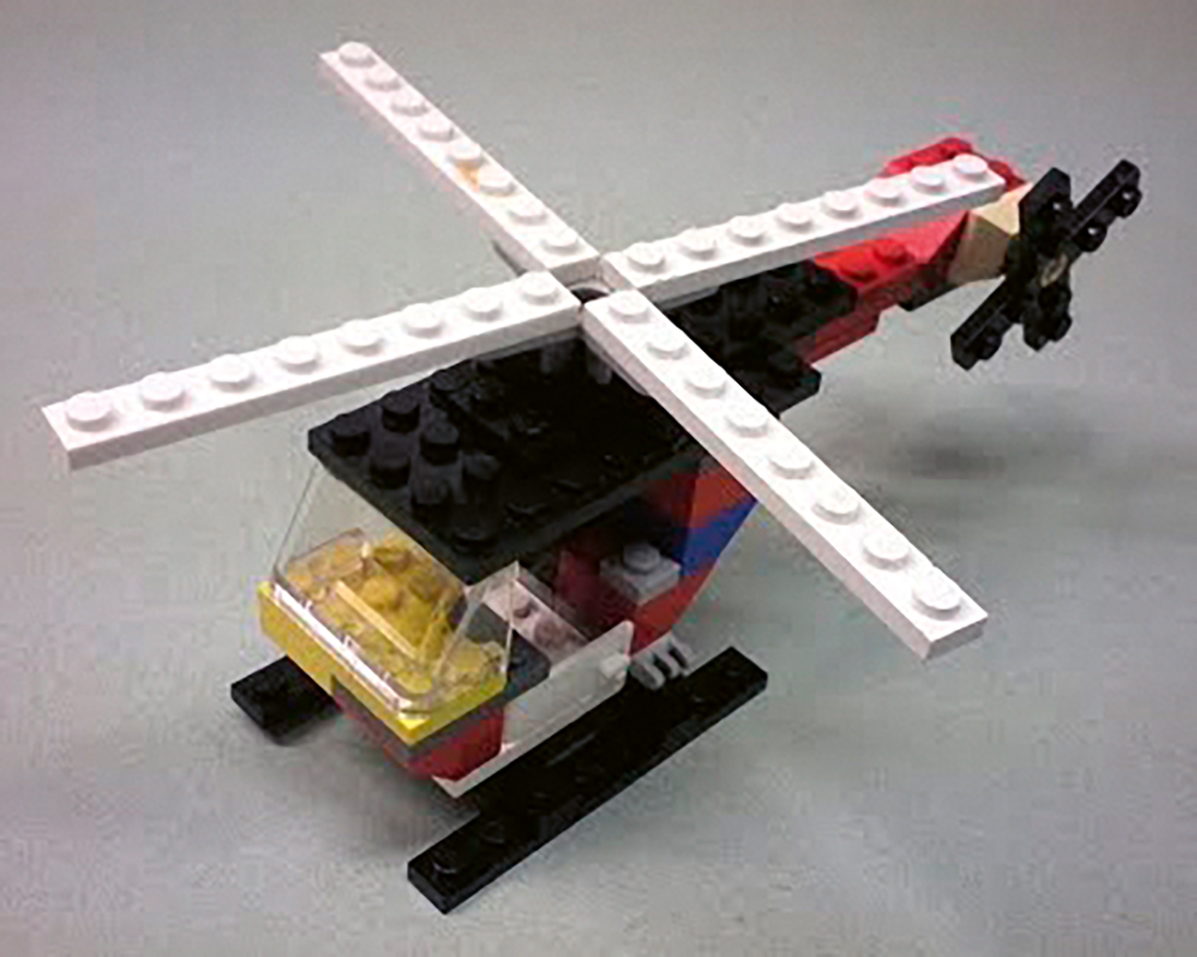
Your cousin’s problem
When she visited your house, your cousin saw a model helicopter that you had built with a construction toy.
She has asked you to send her some instructions to follow so that she can build the same model for herself, using the same construction toy.

Slide 4
Using computational thinking to solve your cousin’s problem
A computer scientist would tackle your cousin’s problem in a logical way, by applying an approach known as computational thinking.
Computational thinking allows us to take a complex problem, understand what the problem is and develop possible solutions.
There are a number of distinct stages or cornerstones to computational thinking. The first is called decomposition.

Slide 5
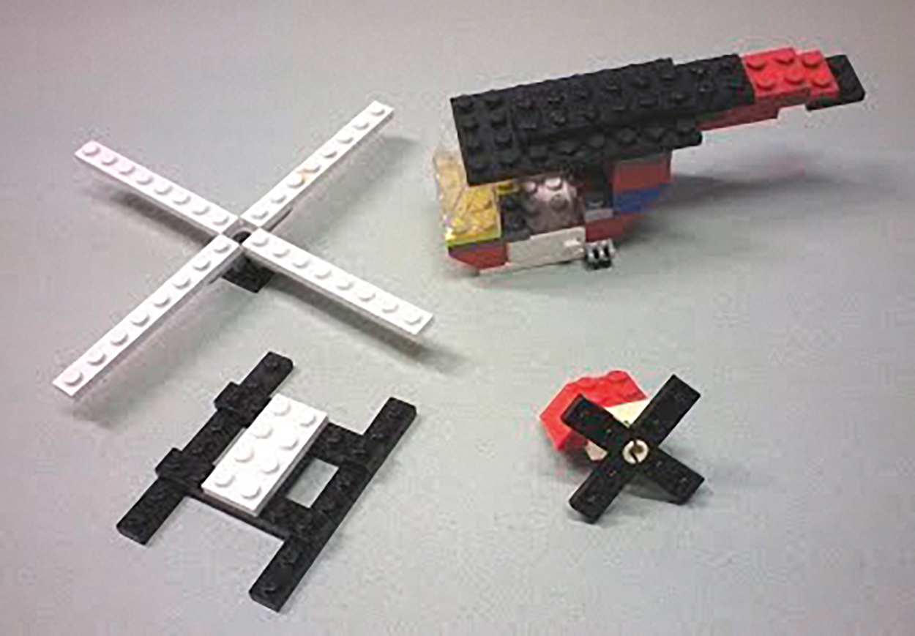
Decomposition
To gain a really good understanding of a complex problem, it helps to break it down or decompose it into a number of smaller problems.

Slide 6
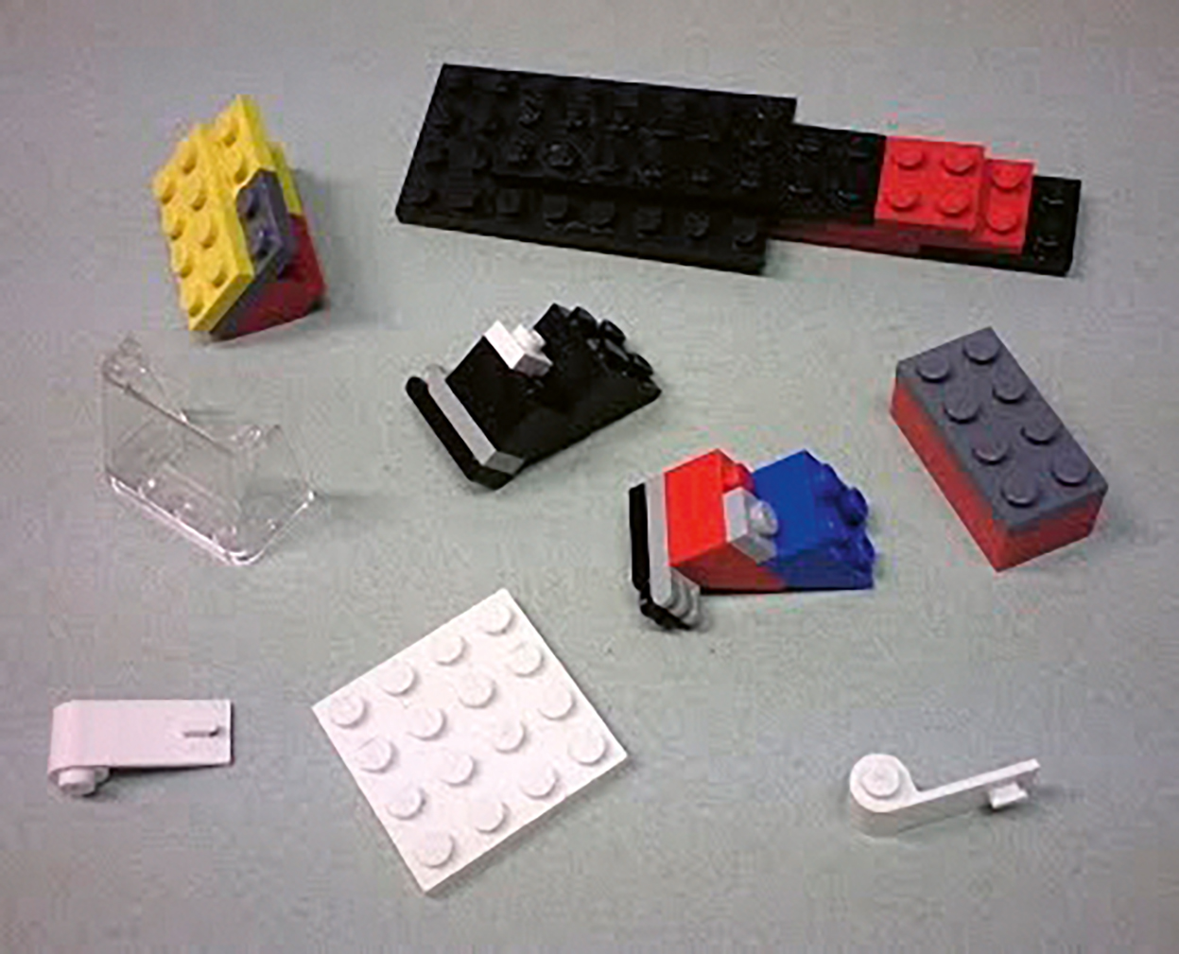
Decomposition
These problems might, in turn, need to be decomposed further until the true nature of the problem is fully understood.

Slide 7
Decomposition
By decomposing a problem, you gain a much deeper understanding of it.
You have broken a problem down into a number of smaller problems. Each one of these smaller problems is easier to solve than the big problem you started with. And when you have solved the smaller problems, you have also solved the big problem.
Decomposition can be applied to any problem, even a simple daily routine such as brushing your teeth.

Slide 8

How do you brush your teeth?
What is involved in brushing your teeth?
What are the things you must do to make sure that your teeth are clean and your gums stay healthy?

Slide 9
How do you brush your teeth?
A teenager’s first attempt at decomposing the problem of how to brush your teeth might look something like this:
place your mobile phone beside you
locate a toothbrush
choose a blue toothbrush
locate the toothpaste
locate the sink
start brushing your teeth
put on some loud music
finish brushing your teeth.

Slide 10
Abstraction
It is illogical and unhelpful to include tasks that do not help you solve your problem.
The second cornerstone of computational thinking is to remove unnecessary and unhelpful detail. This process is known as abstraction.

Slide 11

Activity 1.1: Abstraction

Slide 12
Teeth brushing problem decomposed and abstracted
This is the decomposed problem after abstraction has been carried out:
locate a toothbrush
locate the toothpaste
locate the sink
start brushing your teeth
finish brushing your teeth.

Slide 13
Further decomposition to add sufficient detail
Abstraction removes unhelpful or unnecessary detail.
Further decomposition makes sure that the solution is sufficiently detailed to solve the problem.
The teenager has decomposed the teeth brushing problem and we have abstracted it, but is the list detailed enough?
Let us further decompose the first item in the list: Locate a toothbrush.
What sort of brush do you need?
Is the brush clean?
You need a toothbrush but should it be a manual or an electric toothbrush?
If it is an electric toothbrush, is it charged?
If it needs charging, is there a charging point nearby?
Do you have a brush head that fits an electric toothbrush?

Slide 14
Activity 1.2: Decomposing a daily routine

Slide 15
Algorithm design
The third cornerstone of computational thinking is algorithm design, planning a solution based on your understanding of the problem.
The solution will take the form of a series of simple, logical, step-by-step instructions that must be followed in a strict sequence.
To make a good algorithm, the instructions must be:
clear
simple
unambiguous
precise
correctly sequenced
sufficiently detailed to complete the task.

Slide 16
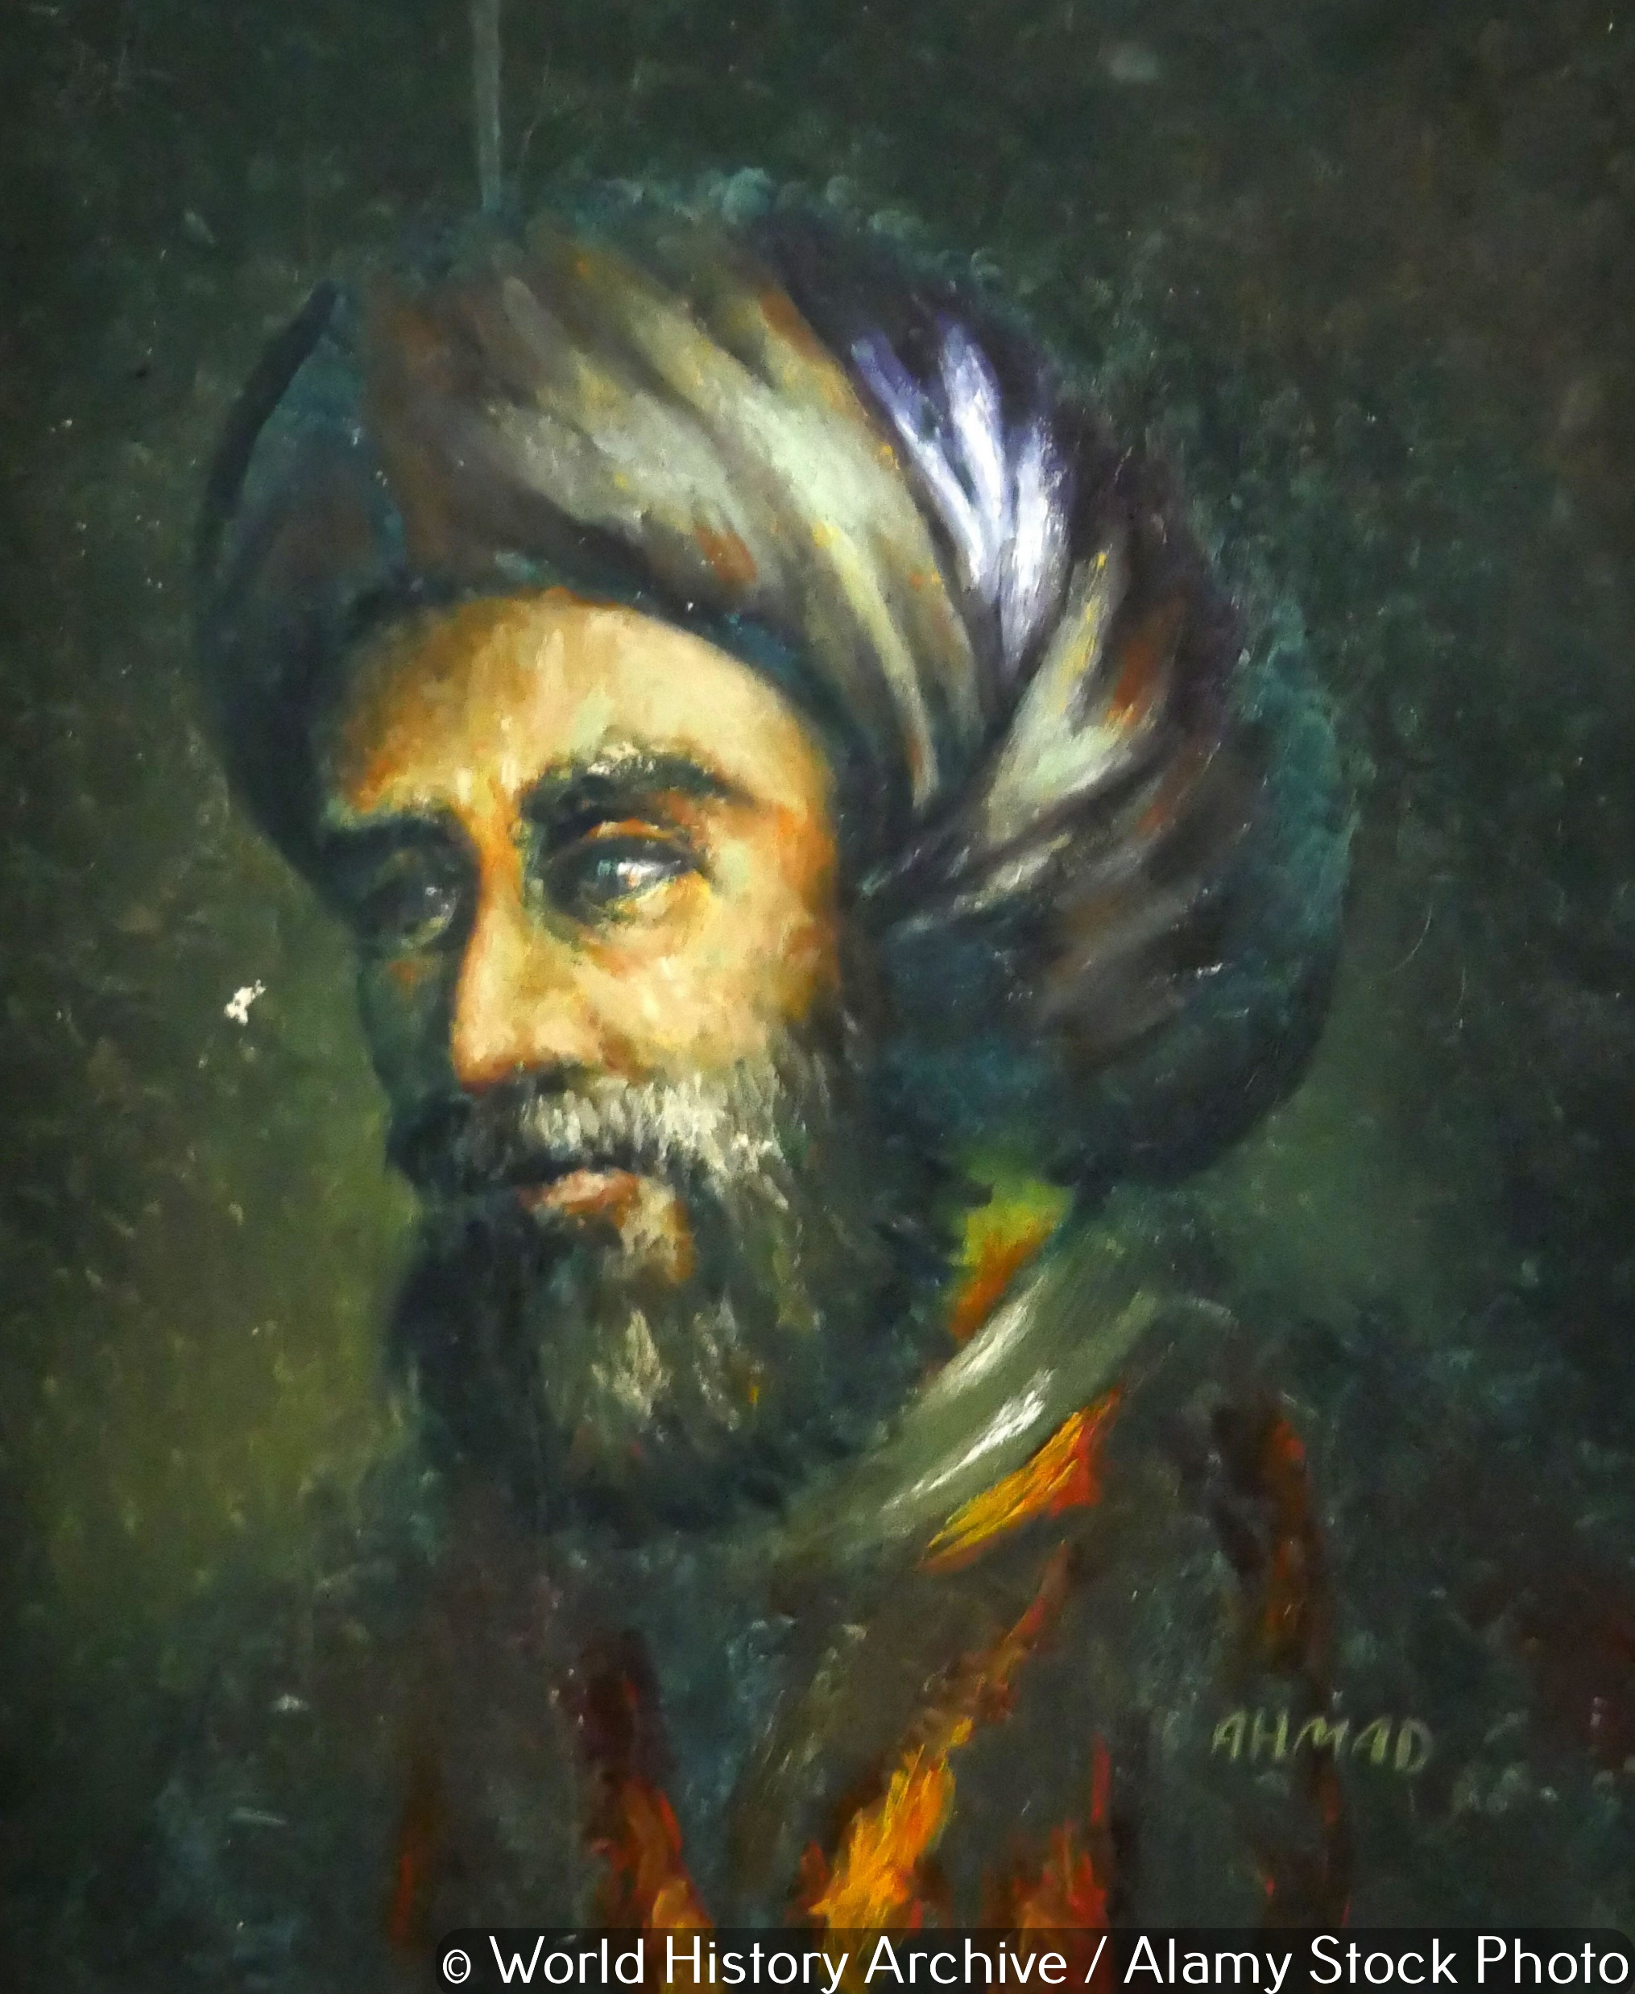
Algorithm
The word ‘algorithm’ is derived from the name of the Persian mathematician and astronomer, al-Khwarizmi (780–850 CE).

Slide 17
Activity 1.3: Paper aeroplane algorithm

Slide 18
Why is a logical approach to problem solving important?
Computational thinking (decomposition, abstraction and algorithm design) is a logical approach to problem solving that is commonly used by computer programmers.
This is because computers can only follow instructions and so, for a computer to implement the solution to a problem, the problem must be written as a series of instructions.

Slide 19
Quiz 1

Slide 20
Activity 1.4: Teach yourself turtle graphics

